Slide 1
Print 4
A
B
C
D

Slide 2





Print 4
Identify the type of process
Write out the special equations for that process
Symbolically solve for ΔE, Q, W, P, V, and T
Identify your contribution to Q_{h} and Q_{c}
Fill in with numbers
$$V_{A}=0.001m^{3}$$
$$V_{C}=0.015m^{3}$$
$T_{A}=1023$K
$$T_{C}=293\text{K}$$
$n=$1mol

Slide 3
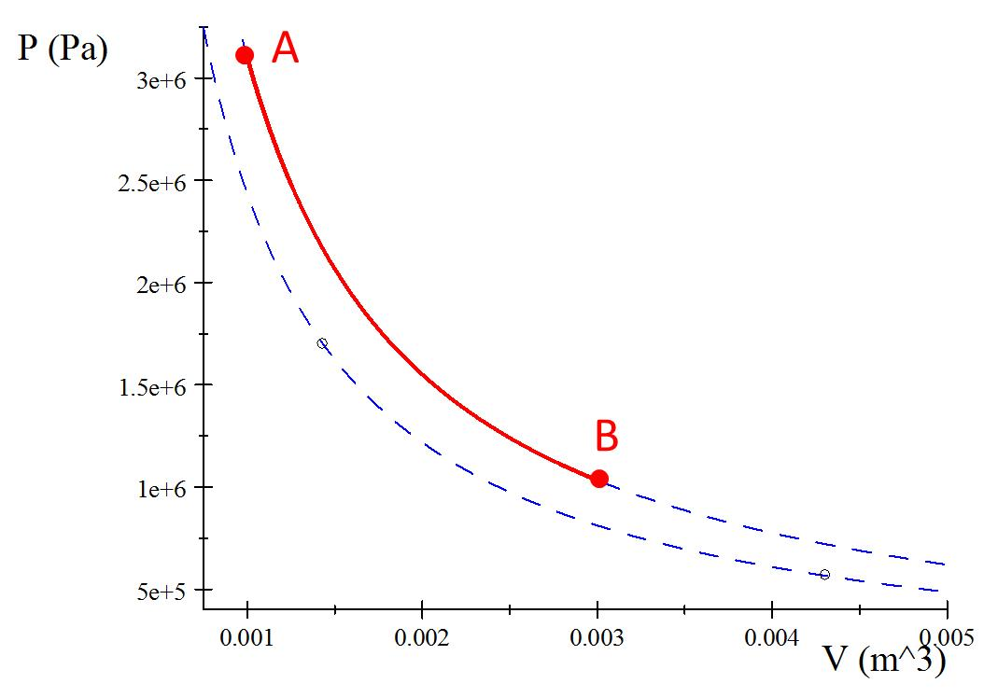

Process A to B
Print 1
Q_{h}

Slide 4
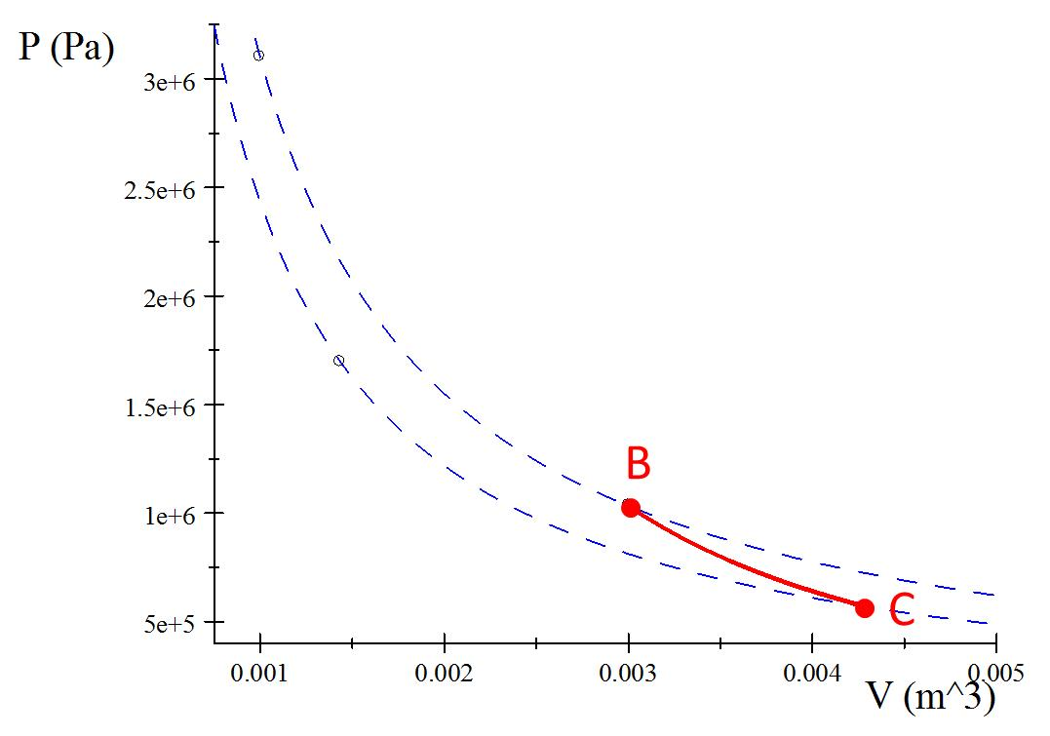
Process B to C
Print 1
Insulator

Slide 5
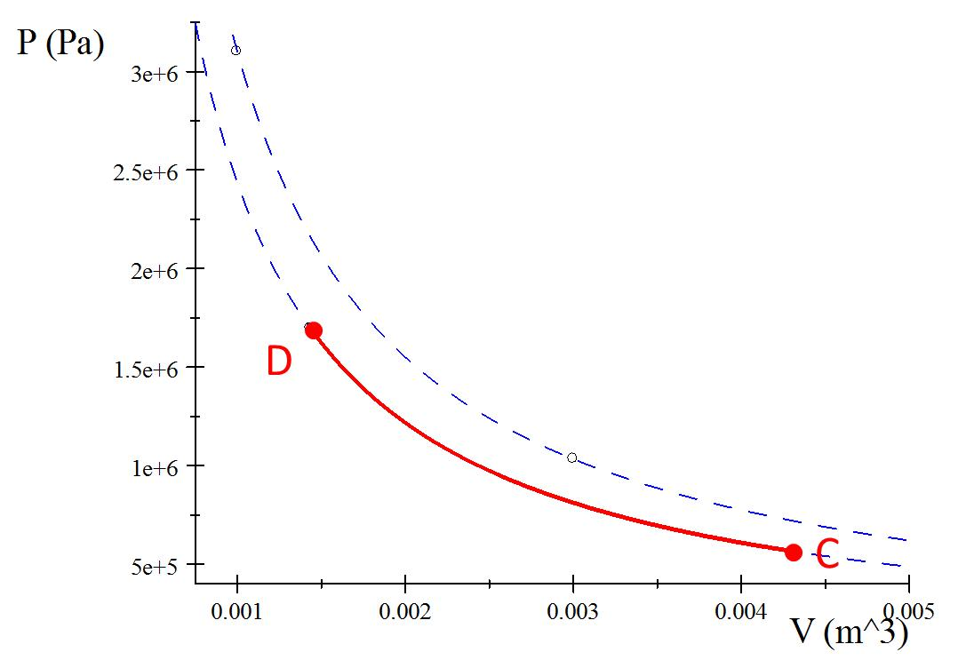
Process C to D
Print 1
Q_{c}

Slide 6
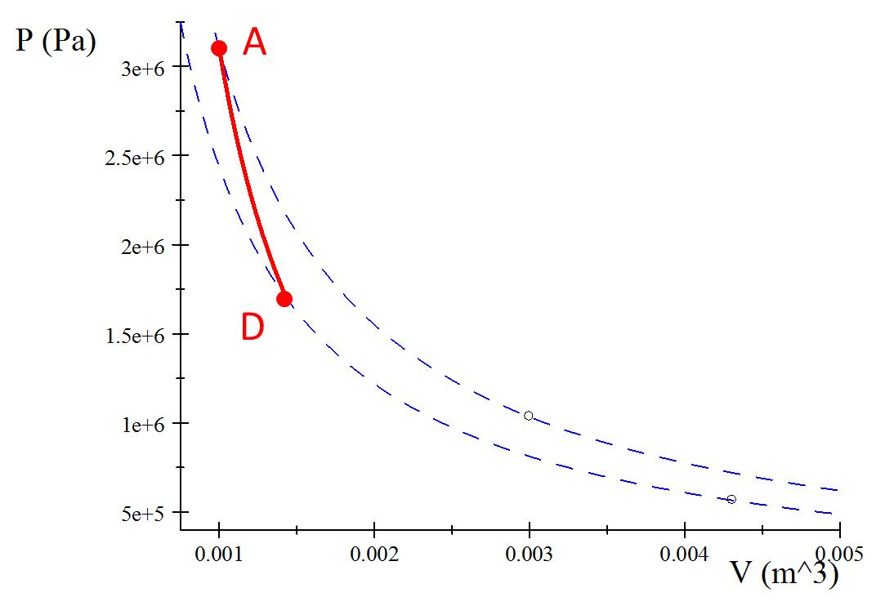
Process D to A
Print 1
Insulator

Slide 7
State | T(K) | P(kPa) | V(m³) | N(mol)
A
B
Process | Q(J) | W(J) | ΔE_{int}(J) | W_{eng}(J) | Q_{h} | Q_{c}
AB

Slide 8
State | T(K) | P(kPa) | V(m³) | N(mol)
B
C
Process | Q(J) | W(J) | ΔE_{int}(J) | W_{eng}(J) | Q_{h} | Q_{c}
BC

Slide 9
State | T(K) | P(kPa) | V(m³) | N(mol)
C
D
Process | Q(J) | W(J) | ΔE_{int}(J) | W_{eng}(J) | Q_{h} | Q_{c}
CD

Slide 10
State | T(K) | P(kPa) | V(m³) | N(mol)
D
A
Process | Q(J) | W(J) | ΔE_{int}(J) | W_{eng}(J) | Q_{h} | Q_{c}
DA

